Slide 1
Cryptography
Syed Md. Mukit Rashid

Slide 2
Resources
https://people.scs.carleton.ca/~paulv/toolsjewels.html
Chapter 2
Goodrich and Tamassia : Chapter 8

Slide 3
Cryptography
Practice and study of techniques for secure communication in the presence of adversarial behavior
Is about constructing and analyzing protocols that prevent third parties or the public from reading private messages
Hidden Writing : Hide the meaning of the message
Depends on secrecy of a short key, not method

Slide 4

Cryptography
Cryptography (cryptographer)
Creating ciphers
Cryptanalysis (cryptanalyst)
Breaking ciphers
The history of cryptography is an arms race between cryptographers and cryptanalysts.

Slide 5
Goals of Cryptography
The most fundamental problem cryptography addresses:
ensure security of communication over insecure medium
What does secure communication mean?
confidentiality (privacy, secrecy) : only the intended recipient can see the communication
integrity (authenticity) : the communication is generated by the alleged sender
Insecure medium
Passive attacker: the adversary can eavesdrop
Active attacker: the adversary has full control over the communication channel

Slide 6
Cryptography < Security
Cryptography isn't the solution to security
Buffer overflows, worms, viruses etc. can still happen and cause damages
Even when used, difficult to get right
Choice of encryption algorithms
Choice of parameters
Implementation
Hard to detect errors : vulnerability can only be recognized after exploitation
..think of Caesar / substitution ciphers

Slide 7
Some Related Security Principles
Open Design Principle
Do not rely on secret designs, attacker ignorance, or security by obscurity.
Kerckhoffs’ principle—a system’s security should not rely on the secrecy of its design details.
Time-tested tools
Rely wherever possible on time-tested, expert-built security tools including protocols, cryptographic primitives and toolkits, rather than designing and implementing your own.
History shows that security design and implementation is difficult to get right even for experts.
Sufficient work factor
tune the mechanism so that the cost to defeat the system (work factor) clearly exceeds the resources of anticipated classes of adversaries.

Slide 8
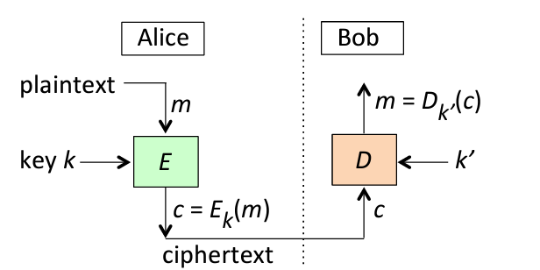
Generic Concepts

Slide 9
Types of Cryptography
Symmetric key
Encryption and decryption keys are the same
Asymmetric key
Encryption and decryption keys differ

Slide 10
Caesar Cipher
Every character is replaced with the character K slots to the right
S E C U R I T Y : V H F X U L W B

Slide 11
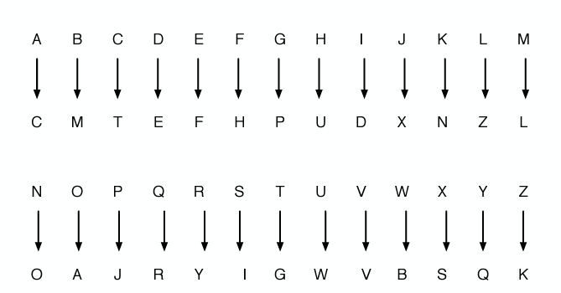
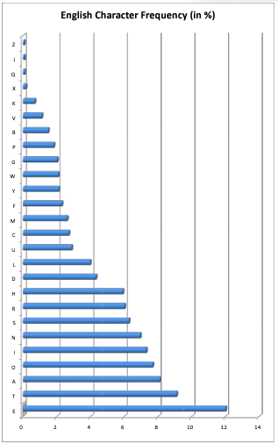
Substitution Cipher

Slide 12
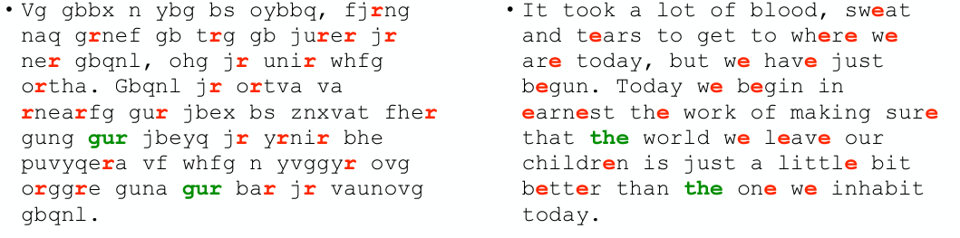
Substitution Cipher

Slide 13
Substitution Cipher

Slide 14
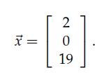


Hill Cipher

Slide 15


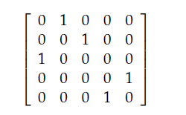

Transposition Cipher

Slide 16

Transposition and Hill Cipher : Problems
We do nothing to hide the statistical distribution of the letters in $M$ Such lack of hiding can leak information.
With enough plaintext-ciphertext pairs, we can solve a straightforward linear system to determine all the values in the matrix used for encryption

Slide 17
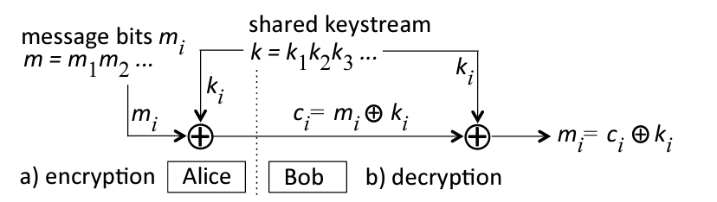
Vernam Cipher

Slide 18
One Time Pads
The key must be at least as long as the plaintext.
The key must be random (uniformly distributed in the set of all possible keys and independent of the plaintext)
The key must never be reused in whole or in part.
The key must be kept completely secret by the communicating parties.

Slide 19
One Time Pads
One-time pads are information-theoretically secure
The encrypted message (i.e., the ciphertext) provides no information about the original message to a cryptanalyst.
A cryptosystem is considered to have information-theoretic security if the system is secure against adversaries with unlimited computing resources and time
A system which depends on the computational cost of cryptanalysis to be secure (and thus can be broken by an attack with unlimited computation) is called computationally or conditionally secure.

Slide 20
One Time Pads : Problems
No Integrity
(C(K) xor "$1000.00") xor ("$1000.00" xor "$9500.00") = C(K) xor "$1000.00" xor "$1000.00" xor "$9500.00" = C(K) xor "$9500.00"
Key as long as message and also has to be secret?
Difficult to generate truly random key.
True random number generators exist, but are typically slower and more specialized.
Very limited practical usage
Practical method of encryption where one or both parties must do all work by hand, without the aid of a computer.
A common use of the one-time pad in quantum cryptography is being used in association with Quantum Key Distribution (QKD).

Slide 21
Stream Ciphers
Plaintext digits are combined with a pseudorandom cipher digit stream (keystream)
In a stream cipher, each plaintext digit is encrypted one at a time with the corresponding digit of the keystream, to give a digit of the ciphertext stream.
Not information theoretically secure
https://en.wikipedia.org/wiki/Stream_cipher

Slide 22

Attacks on Stream Ciphers
vulnerable to attacks if certain precautions are not followed:
Keys must never be used twice (Reused key attack)
Even if neither message is known, as long as both messages are in a natural language, such a cipher can often be broken by paper-and-pencil methods

Slide 23
Attacks on Stream Ciphers
vulnerable to attacks if certain precautions are not followed:
Valid decryption should never be relied on to indicate authenticity
Bit-flipping attacks can be prevented by including message authentication code to increase the likelihood that tampering will be detected

Slide 24
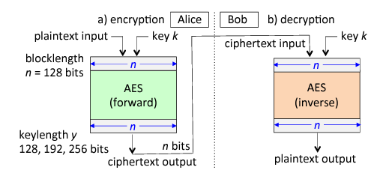
Block Ciphers
processes plaintext in fixed-length chunks or blocks
Each block, perhaps a group of ASCII-encoded characters, is encrypted with a fixed transformation dependent on the key
Main properties of algorithm : block-length and key-length
If the last plaintext block has fewer bits than the block-length, it is padded with “filler” characters

Slide 25
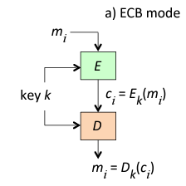
Block Ciphers : Modes of Operation
ECB (Electronic Code Book) : Each encryption block operation is independent of adjacent blocks
If a given key k is used to encrypt several identical plaintext blocks m_i, then identical ciphertext blocks c_i result
Various methods called modes of operation combine successive n-bit block operations such that the encryption of one block depends on other blocks

Slide 26
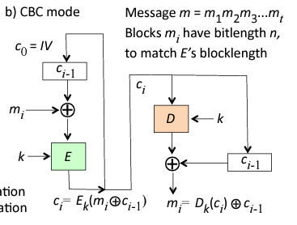
Block Ciphers : Modes of Operation

Slide 27
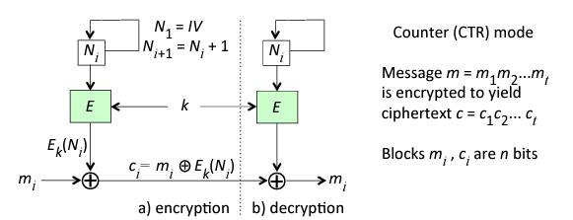
Block Ciphers : Modes of Operation

Slide 28
Types of Attacks
Ciphertext only attack
Known plaintext attack
Chosen plaintext attack
Chosen ciphertext attack

Slide 29
Data Encryption Standard (DES)
https://en.wikipedia.org/wiki/Data_Encryption_Standard

Slide 30
Advanced Encryption Standard (AES)
Based on a design principle known as a substitution–permutation network, and is efficient in both software and hardware.
Takes a block of the plaintext and the key as inputs, and applies several alternating rounds or layers of substitution boxes (S-boxes) and permutation boxes (P-boxes) to produce the ciphertext block
The key is introduced in each round, usually in the form of "round keys" derived from it.
Decryption is done by simply reversing the process.

Slide 31
Substitution–Permutation Network
An S-box substitutes a small block of bits (the input of the S-box) by another block of bits (the output of the S-box).
This substitution should be one-to-one, to ensure invertibility (hence decryption).
A P-box is a permutation of all the bits
It takes the outputs of all the S-boxes of one round, permutes the bits, and feeds them into the S-boxes of the next round.
A good P-box has the property that the output bits of any S-box are distributed to as many S-box inputs as possible.
The round key (obtained from the key with some simple operations, for instance, using S-boxes and P-boxes) is combined using some group operation, typically XOR.

Slide 32
Substitution–Permutation network : Target
A single typical S-box or a single P-box alone does not have much cryptographic strength
An S-box could be thought of as a substitution cipher, while a P-box could be thought of as a transposition cipher.
A well-designed SP network with several alternating rounds of S- and P-boxes already satisfies Shannon's confusion and diffusion properties
These properties, when present, work to thwart the application of statistics and other methods of cryptanalysis.

Slide 33
Shannon’s Confusion and Diffusion Properties
Confusion means that each binary digit (bit) of the ciphertext should depend on several parts of the key, obscuring the connections between the two.
Diffusion means that if we change a single bit of the plaintext, then about half of the bits in the ciphertext should change, and similarly, if we change one bit of the ciphertext, then about half of the plaintext bits should change.

Slide 34
AES (Advanced Encryption Standard)
Based on the substitution–permutation network design principle
Is efficient in both software and hardware
Steps:
Key expansion
Initial round key addition
9/11/13 rounds of subBytes, shiftRow and mixColumn and addRoundKey
Final row of shiftRow, mixColumn and addRoundKey

Slide 35
AES (Advanced Encryption Standard)
subBytes Step: Uses S-Box
Avoid attacks based on simple algebraic properties
The Rijndael S-box was specifically designed to be resistant to linear and differential cryptanalysis.
Minimizing the correlation between linear transformations of input/output bits.
Minimizing the difference propagation probability.
Obscures the relationship between the key and the ciphertext, thus ensuring Shannon's property of confusion.

Slide 36
AES (Advanced Encryption Standard)
shiftRows
Avoids the columns being encrypted independently, otherwise AES would degenerate into four independent block ciphers
mixColumns:
Together with ShiftRows, MixColumns provides diffusion in the cipher.

Slide 37
Attacks on Block Ciphers
Linear Cryptanalysis:
General form of cryptanalysis based on finding affine approximations to the action of a cipher
Steps:
Construct linear equations relating plaintext, ciphertext and key bits that have a high bias; that is, whose probabilities of holding are as close as possible to 0 or 1
Use these linear equations in conjunction with known plaintext-ciphertext pairs to derive key bits.

Slide 38
Attacks on Block Ciphers
Differential Cryptanalysis:
It is the study of how differences in information input can affect the resultant difference at the output
The attacker then computes the differences of two ciphertexts of two known plaintexts, hoping to detect statistical patterns in their distribution
Statistical properties depend upon the nature of the S-boxes used for encryption

Slide 39
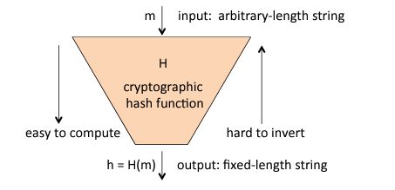
Cryptographic Hash Function
A cryptographic hash function (CHF) is a mathematical algorithm that maps data of an arbitrary to a bit array of a fixed size

Slide 40
Cryptographic Hash Function : Properties
One-way property (or preimage resistance)
for essentially all possible hash values h, given h it should be infeasible to find any m such that H(m) = h.
Second preimage resistance
Given any first input m1, it should be infeasible to find any distinct second input m2 such that H(m1) = H(m2)
Also known as weak collision resistance
Collision resistance
It should be infeasible to find any pair of distinct inputs m1, m2 such that H(m1) = H(m2)
Also known as strong collision resistance

Slide 41
Collision Resistant Hash Functions
Second-preimage resistance fails to guarantee collision resistance
Fixing one string (say m1 in H2) makes collision-finding significantly more costly
Reason : Birthday Paradox

Slide 42
The Birthday Paradox
What number n of people are needed in a room before a shared birthday is expected among them (i.e., with probability p = 0.5)?
Ans. Only 23.
Related Question : Given n people in a room, what is the probability that two of them have the same birthday?
P = 0.71 for n = 30
P = 0.97 for n = 50
In security, attackers can often solve problems more efficiently than expected !
The “collision” here is not for one pre-specified day (e.g., your birthday); any matching pair will do

Slide 43


The Birthday Paradox
Probability that ith message does not collide with previous i-1 messages is:
Probability that attacker has not found any collision after k messages:

Slide 44



The Birthday Paradox

Slide 45
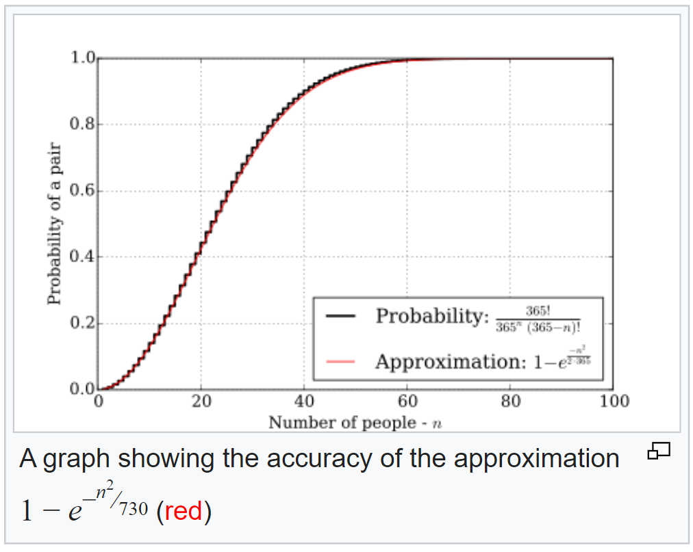
The Birthday Paradox

Slide 46
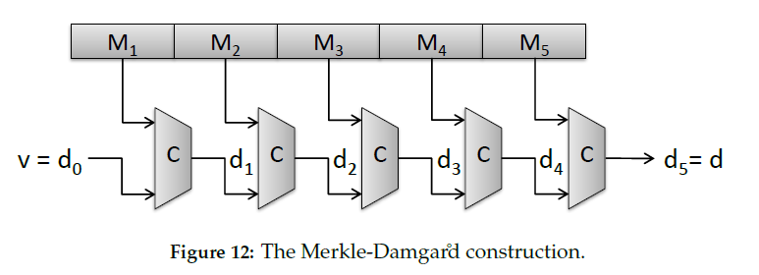
Hash Function Design : The Merkle-Damgard Construction

Slide 47

Hash Function Design : The Merkle-Damgard Construction
A hash function built with the Merkle–Damgård construction is as resistant to collisions as is its compression function
Any collision for the full hash function can be traced back to a collision in the compression function
Thus, it is important for a compression function to have strong collision resistance.

Slide 48
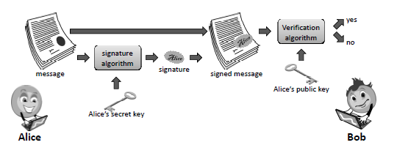
Digital Signature

Slide 49
Digital Signature
Digital signature provides 3 important properties
Data origin authentication: assurance of who originated (signed) a message or file
Data integrity: assurance that received content is the same as that originally signed.
Non-repudiation: strong evidence of unique origination, making it hard for a party to digitally sign data and later successfully deny having done so.

Slide 50
RSA algorithm steps (Recap)
Key-Generation
Step-1: Select two large prime numbers p and q where p ≠ q.
Step-2: Calculate n = p * q.
Step-3: Calculate Ф(n) = (p-1) * (q-1).
Step-4: Select e such that, e is relatively prime to Ф(n), i.e. gcd(e, Ф(n)) = 1 and 1 < e < Ф(n)
Step-5: Calculate d = e ⁻¹ mod Ф(n) or ed = 1 mod Ф(n).
Step-6: Public key = {e, n}, private key = {d, n}.

Slide 51
RSA algorithm steps (Recap)
Step – 1: Select two prime numbers p and q where p ≠ q.
Example, Two prime numbers p = 13, q = 11.
Step – 2: Calculate n = p * q.
Example, n = p * q = 13 * 11 = 143.
Step – 3: Calculate Ф(n) = (p-1) * (q-1).
Example, Ф(n) = (13 – 1) * (11 – 1) = 12 * 10 = 120.
Step – 4: Select e such that, e is relatively prime to Ф(n),
i.e. gcd(e, Ф(n)) = 1 and 1 < e < Ф(n).
Example, Select e = 13, gcd (13, 120) = 1.
See Euler’s Totient

Slide 52
RSA algorithm steps (Recap)
Step – 5: Calculate d = e ⁻¹ mod Ф(n) or e * d = 1 mod Ф(n)
Example, Finding d: e * d mod Ф(n) = 1
13 * d mod 120 = 1
(How to find: d *e = 1 mod Ф(n)
d = ((Ф(n) * i) + 1) / e
d = (120 + 1) / 13 = 9.30 (∵ i = 1)
d = (240 + 1) / 13 = 18.53 (∵ i = 2)
d = (360 + 1) / 13 = 27.76 (∵ i = 3)
d = (480 + 1) / 13 = 37 (∵ i = 4))
Step – 6: Public key = {e, n}, private key = {d, n}.
Example, Public key = {13, 143}
and private key = {37, 143}.

Slide 53
RSA algorithm steps : Encryption
Find out cipher text using the formula,
C = P^{e} mod n where, P < n.
Example, Plain text P = 13. (Where, P < n)
C = P^{e} mod n = 13¹³ mod 143 = 52.

Slide 54
RSA algorithm steps : Decryption
P = C^{d} mod n. Plain text P can be obtain
using the given formula.
Example, Cipher text C = 52
P = C^{d} mod n = 52³⁷ mod 143 = 13.

Slide 55



RSA Signature Scheme
Similar to the RSA Algorithm

Slide 56


RSA Signature Scheme : Problem
Existential Forgery

Slide 57
RSA Signature Scheme : Problem
Solution : Sign on the cryptographic hash of the message
H(M) . H(N) very unlikely to match H(M.N)
Digest much smaller than original message m
Improves efficiency

Slide 58
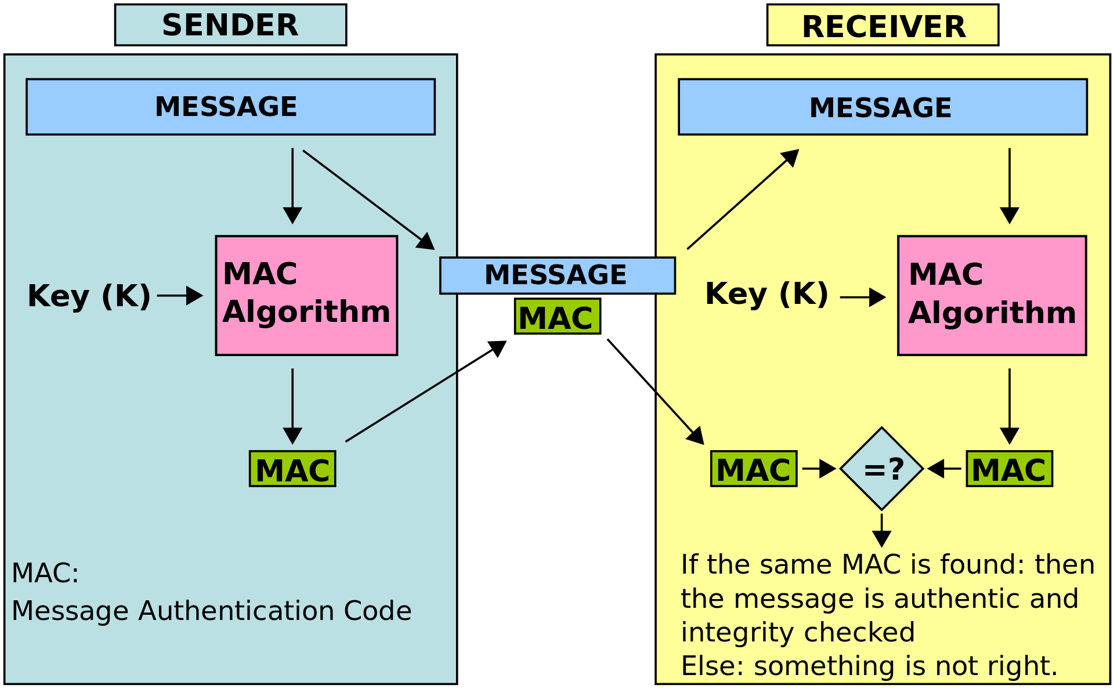
Message Authentication Code (MAC)
Provides authentication and integrity

Slide 59


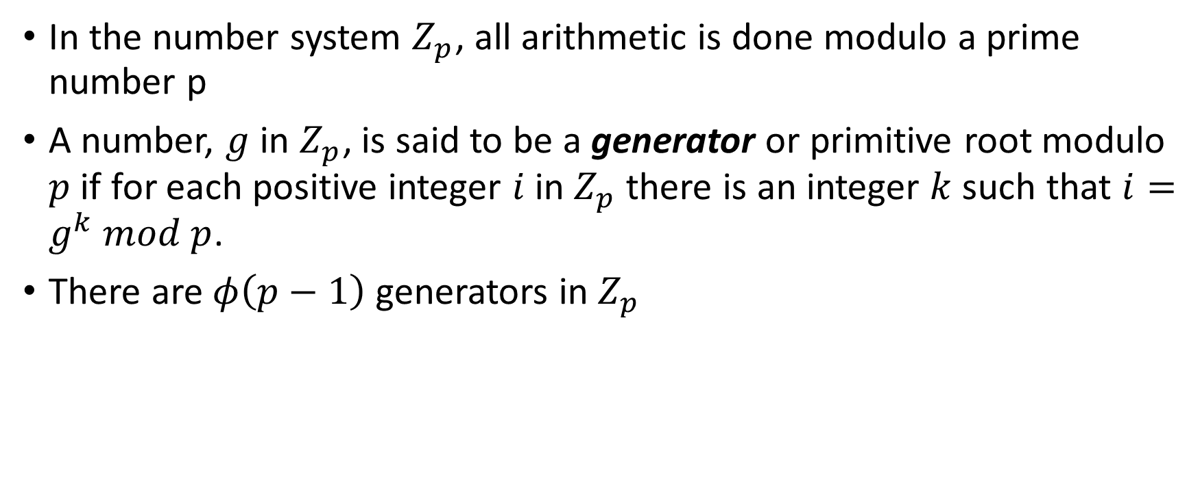
The Elgamal Cryptosystem
In the number system $Z_{p}$, all arithmetic is done modulo a prime number p
A number, $g$ in $Z_{p}$, is said to be a generator or primitive root modulo $p$ if for each positive integer $i$in $Z_{p}$ there is an integer $k$such that $i=g^{k} mod p$.
There are $φ\left(p−1\right)$ generators in $Z_{p}$

Slide 60

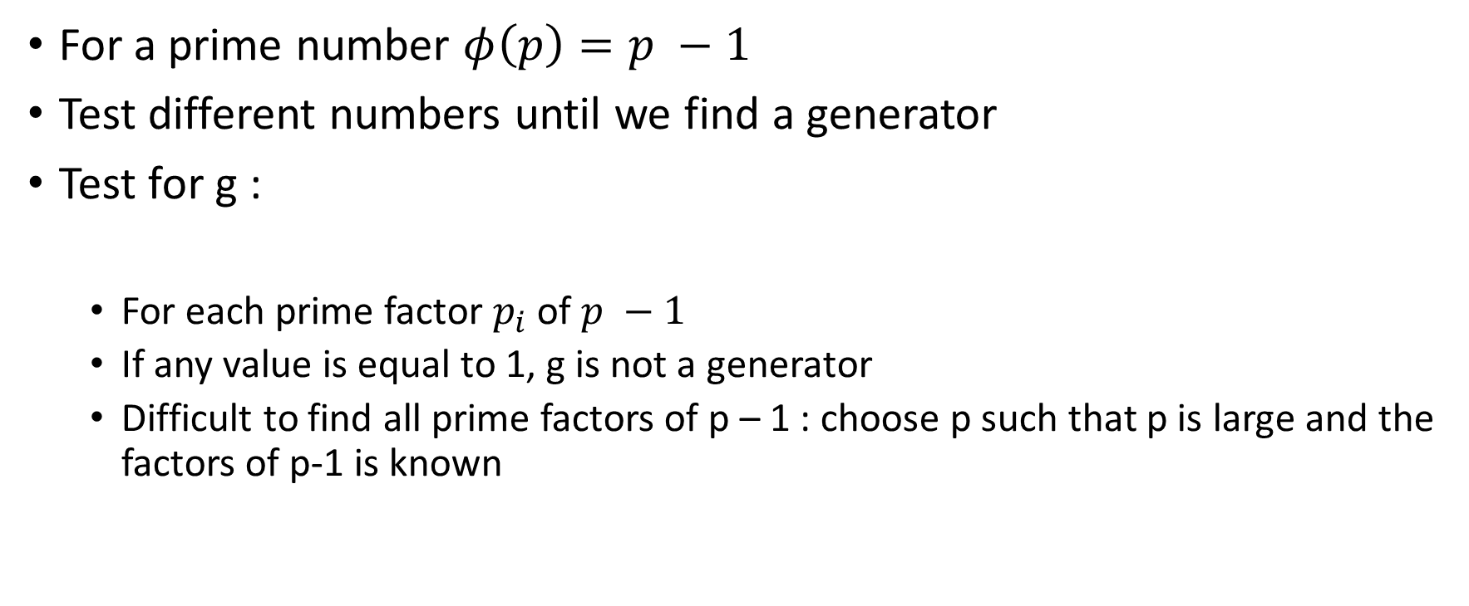
The Elgamal Cryptosystem
For a prime number $φ\left(p\right)=p −1$
Test different numbers until we find a generator
Test for g :
For each prime factor $p_{i}$ of $p −1$
If any value is equal to 1, g is not a generator
Difficult to find all prime factors of p – 1 : choose p such that p is large and the factors of p-1 is known

Slide 61
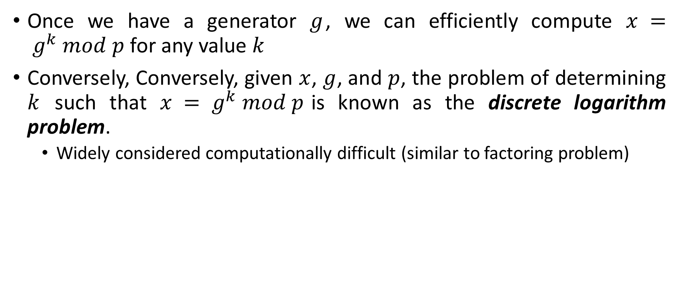
The Elgamal Cryptosystem
Once we have a generator $g$, we can efficiently compute $x = g^{k} mod p$for any value $k$
Conversely, Conversely, given $x$, $g$, and $p$, the problem of determining $k$ such that $x = g^{k} mod p$is known as the discrete logarithm problem.
Widely considered computationally difficult (similar to factoring problem)

Slide 62
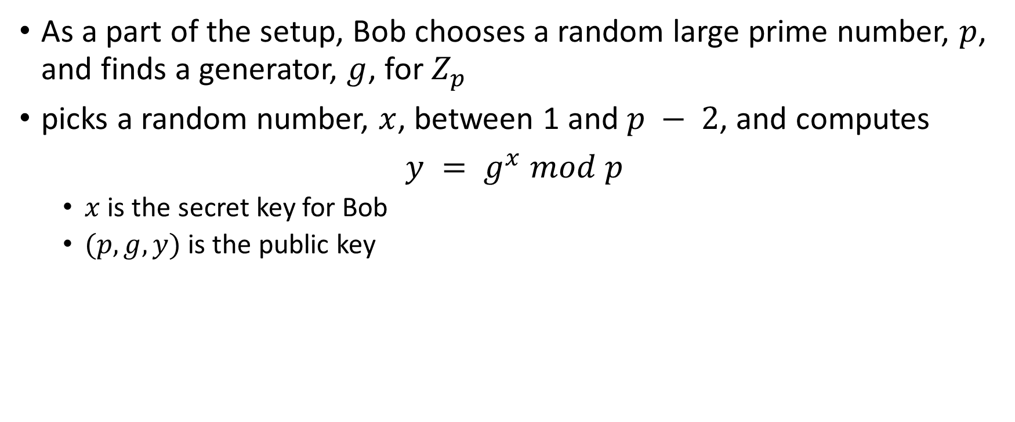
The Elgamal Cryptosystem
As a part of the setup, Bob chooses a random large prime number, $p$, and finds a generator, $g$, for $Z_{p}$
picks a random number, $x$, between 1 and $p − 2$, and computes
$y = g^{x} mod p$
$x$ is the secret key for Bob
$(p,g,y)$ is the public key

Slide 63


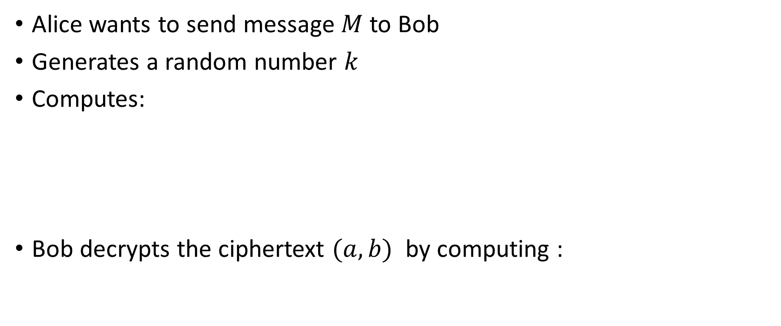
The Elgamal Cryptosystem
Alice wants to send message $M$ to Bob
Generates a random number $k$
Computes:
Bob decrypts the ciphertext $(a,b)$ by computing :

Slide 64
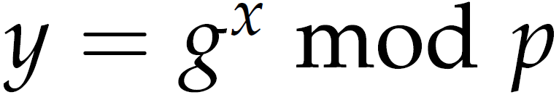
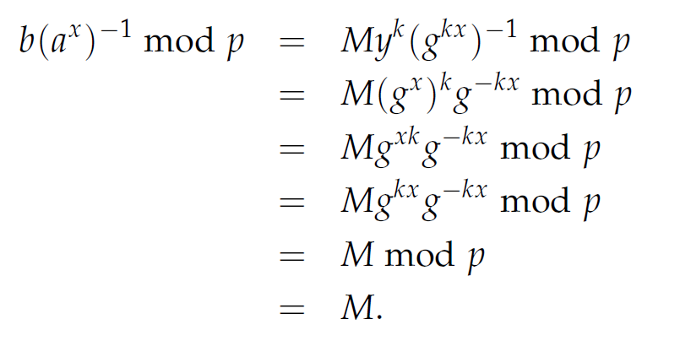
The Elgamal Cryptosystem

Slide 65
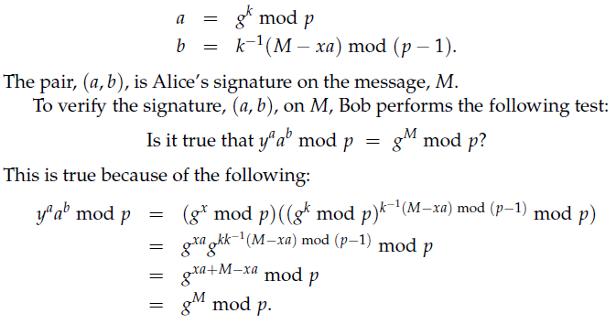
The Elgamal Signature Scheme

Slide 66
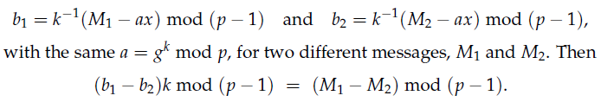

The Elgamal Signature Scheme : Caution
Alice should never reuse the same $k$ twice

Slide 67
Key Exchange Protocol
A key exchange protocol is a cryptographic approach to establishing a shared secret key by communicating solely over an insecure channel, without any previous private communication.
Shared secret key for symmetric encryption
Assumption : Attacker cannot actively modify message
it can be shown that no key exchange protocol exists if the adversary can actively modify messages sent over the insecure channel
Passive eavesdropping on channel

Slide 68
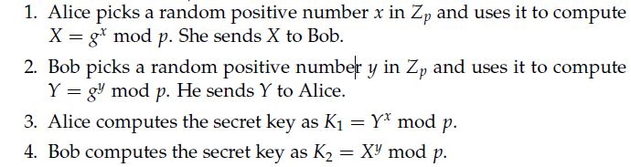
Diffie-Hellman Key Exchange Protocol (DH)

Slide 69
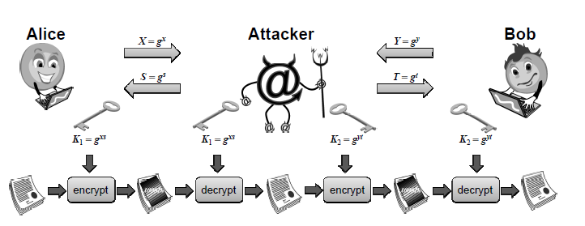
Man In the Middle Attack

Slide 70
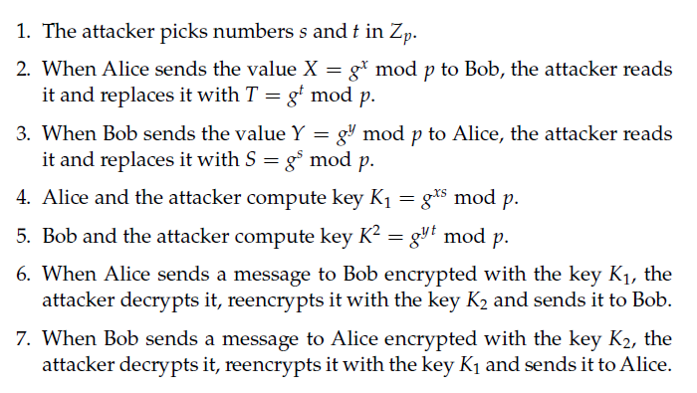
Man In the Middle Attack

Slide 71
References
https://en.wikipedia.org/wiki/Substitution%E2%80%93permutation_network
https://en.wikipedia.org/wiki/Confusion_and_diffusion
https://en.wikipedia.org/wiki/Advanced_Encryption_Standard

